Slide 1
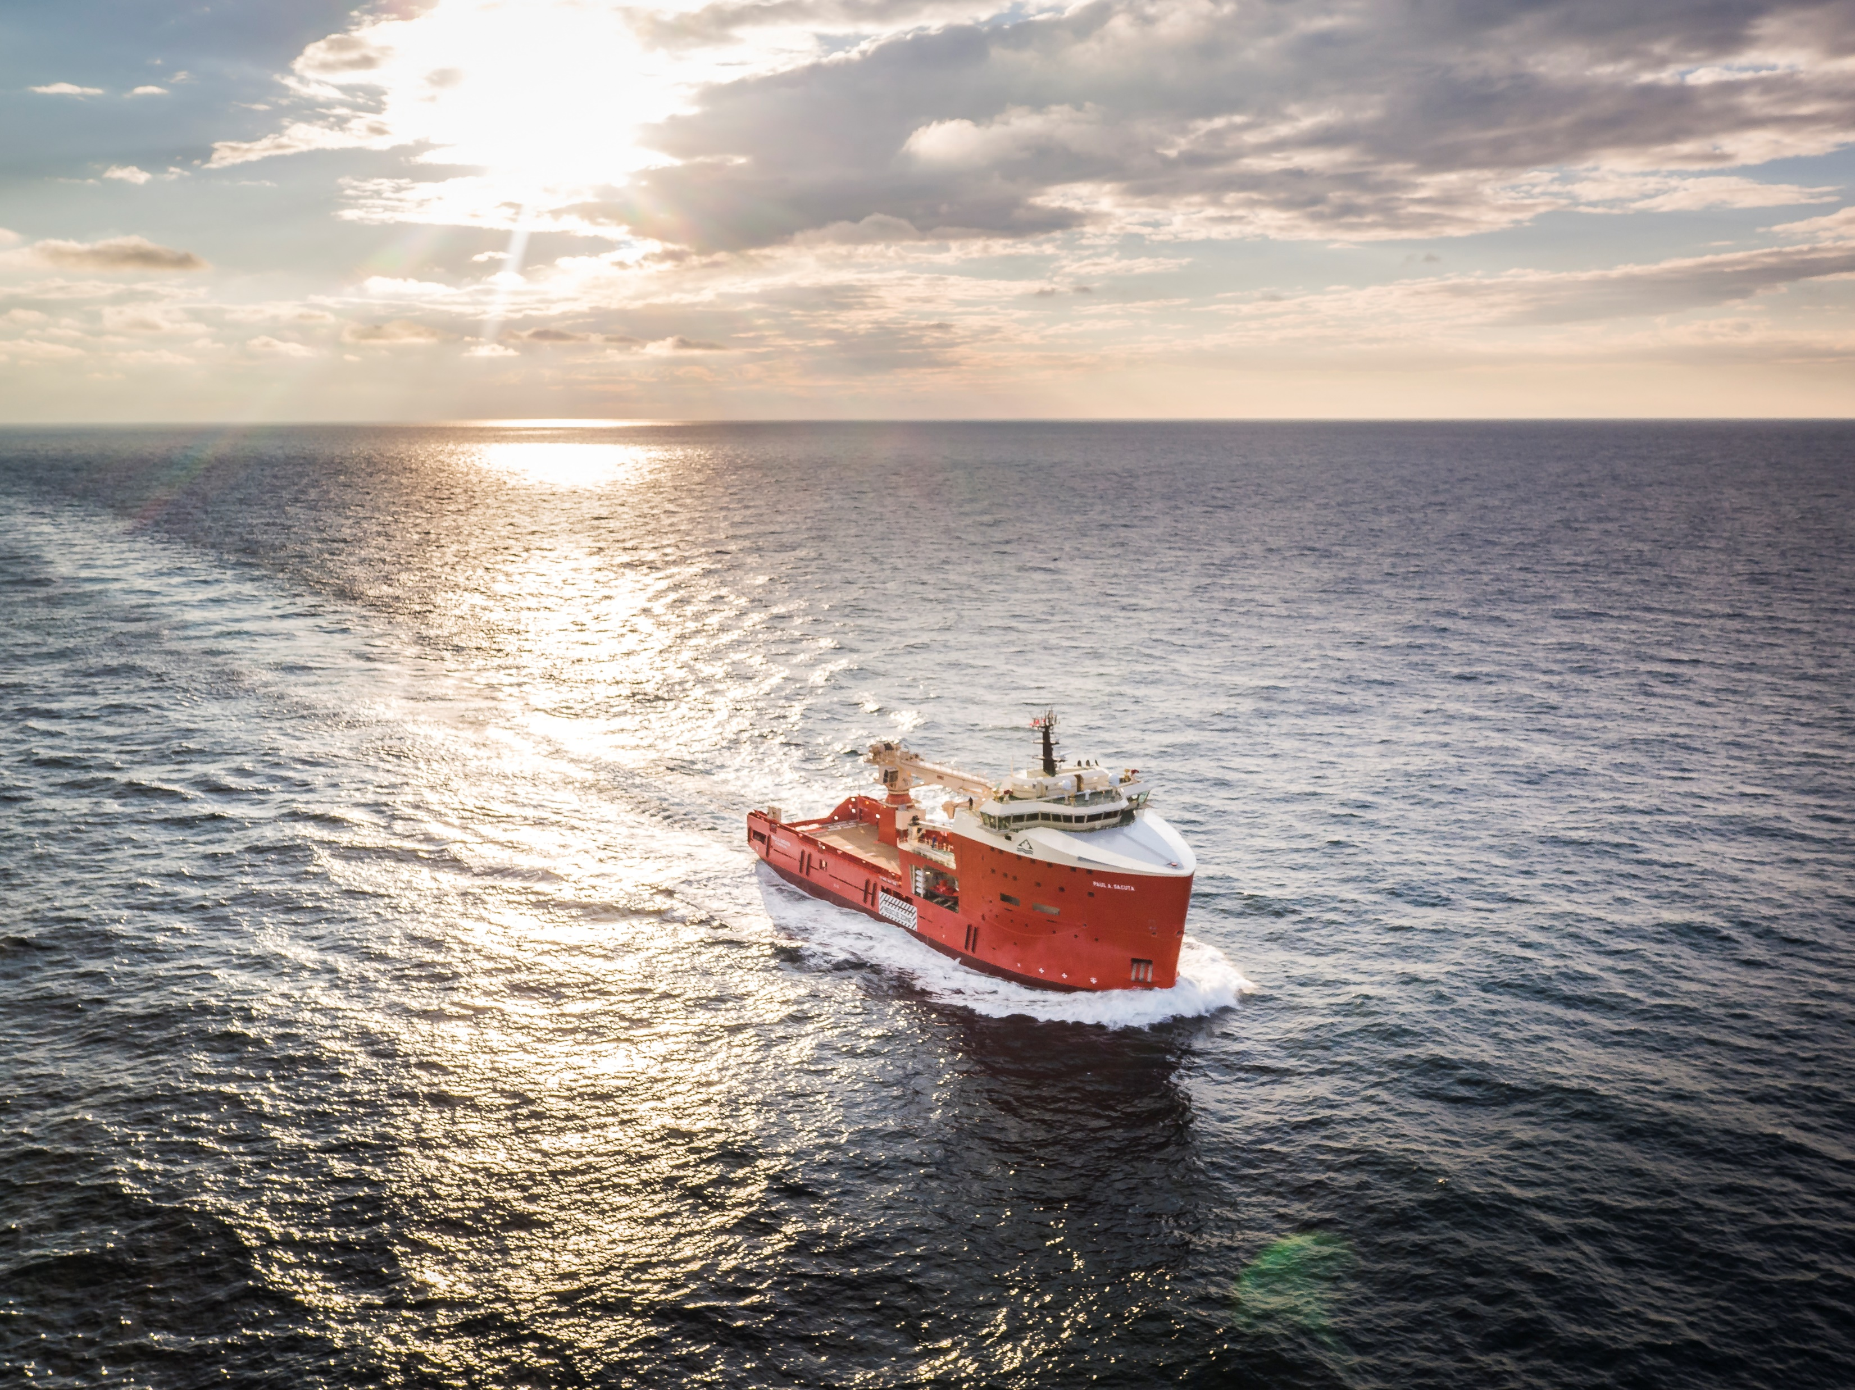


Manoeuvrability and communication requirements for safe operation when manned and unmanned vessels meet
Ingmar Wever
MSc Thesis Presentation
December 19, 2018
Notes:
Welcome all, I’m glad you are all here.
Today I’m going to present my research into the manoeuvrability and communication requirements for safe operation when manned and unmanned vessels meet.

Slide 2
Why autonomous shipping?
Improved safety
Lower cost
More comfort and attractive industry
Notes:
The first question you might ask yourself is: Why do we want to sail autonomously. From literature, three key arguments have been identified as push factors.
First the improved safety, human errors cause most accidents. Thus removing humans from the chain of command, will mitigate this risk. It should be noted that people also do things which computers cannot do yet. Another related advantage is that less crew is at sea, thus less crew is at risk during accidents.
The second is the reduction in cost, manning is a large portion of the total cost. Automation will reduce the amount of crew necessary. This crew should, however, be educated better.
More comfort and attractive industry, as people can have more regular hours to work and do not have to be away for many weeks when working remote.

Slide 3
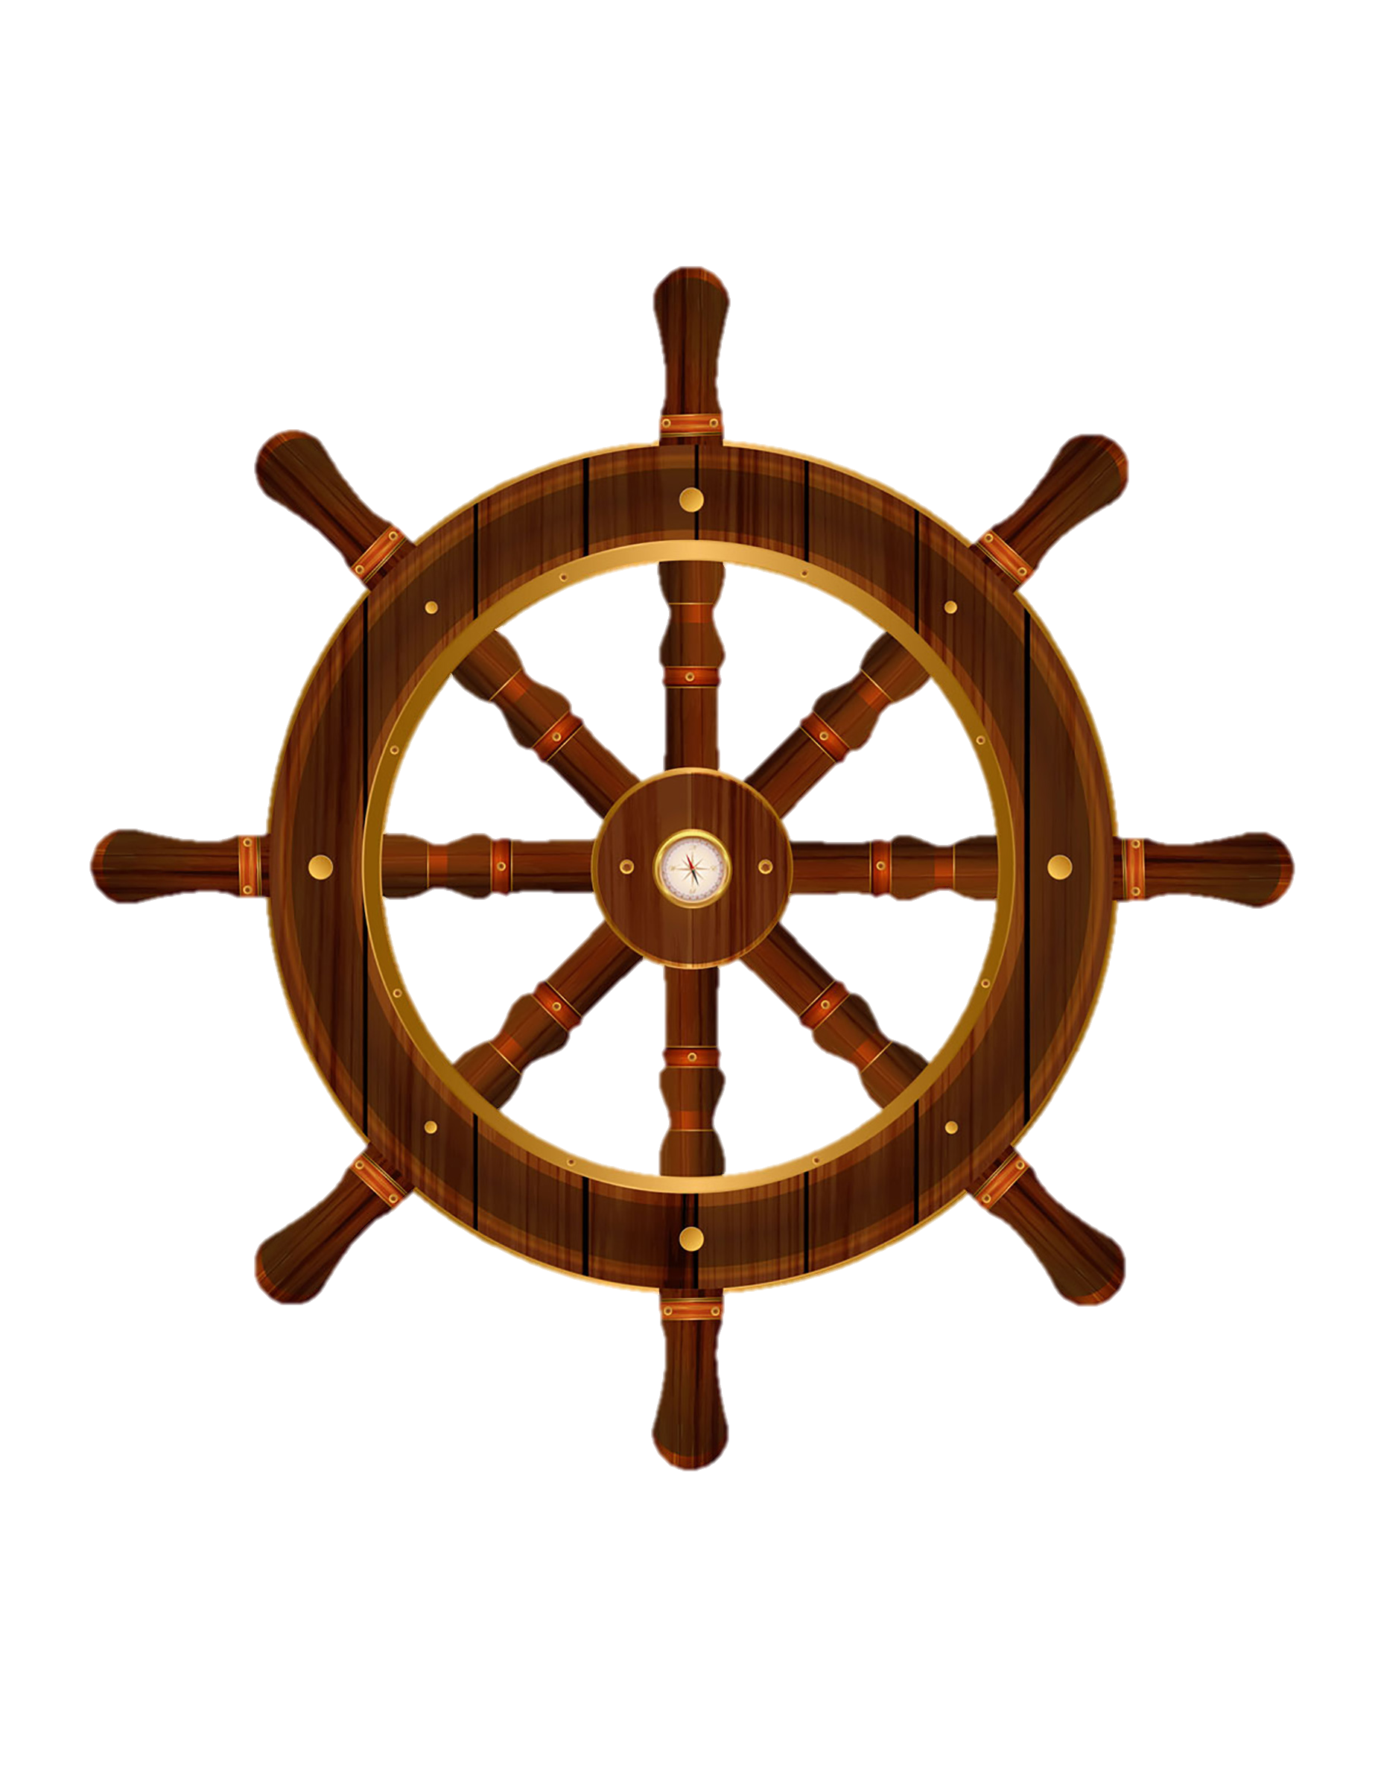



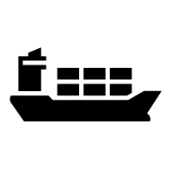

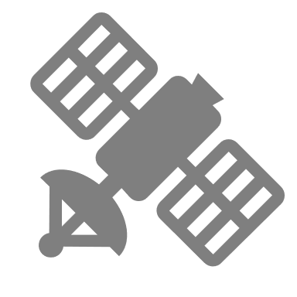



 | Level of autonomy | Course and speed |  | Monitoring of environment | Fallback when automation fails | Automated system in control
0 | No automation
1 | Driver assistance
2 | Partial automation
3 | Conditional automation
4 | High automation
5 | Full automation
Manned
Automated
Remote
Fully autonomous
Notes:
Here you see a commonly used definition for autonomous vehicles. This includes Tesla and ships. As you can see are there different levels of autonomy. For each level is defined what should be done in an automated manner, and what is the responsibility of the crew.
In this research did I focus on level 4 autonomy, which means that the human is taken out of the chain of command completely. Thus it even has to handle emergency situations, where systems fail. Most of the current project presented as autonomous vessel are remotely operated. In those cases is still a human in command, thus lower levels of autonomoy.

Slide 4
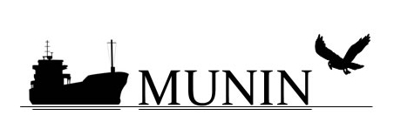
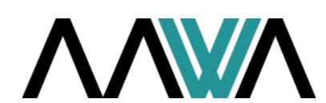
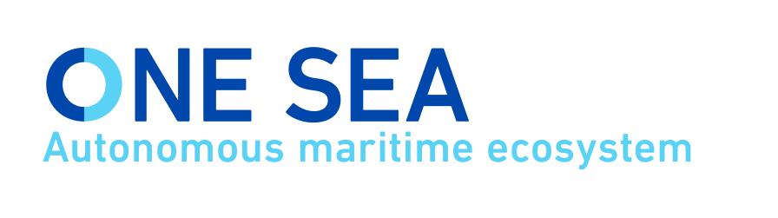
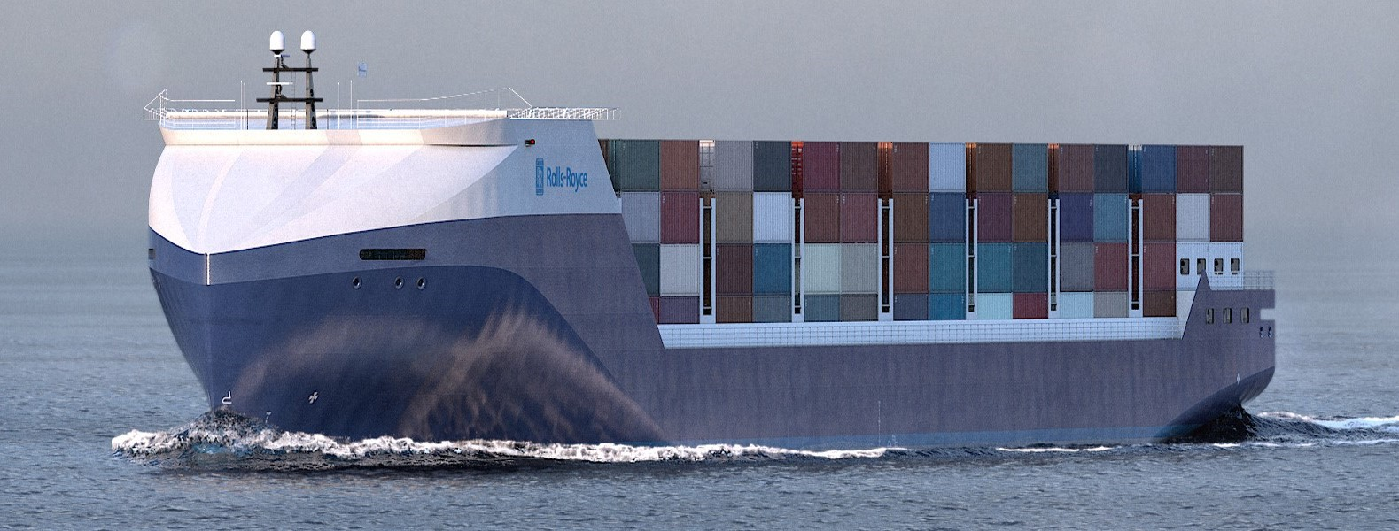
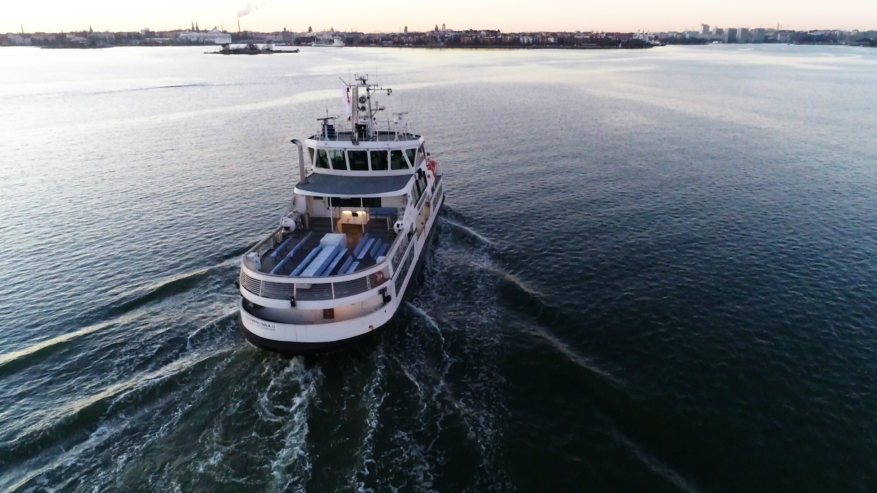
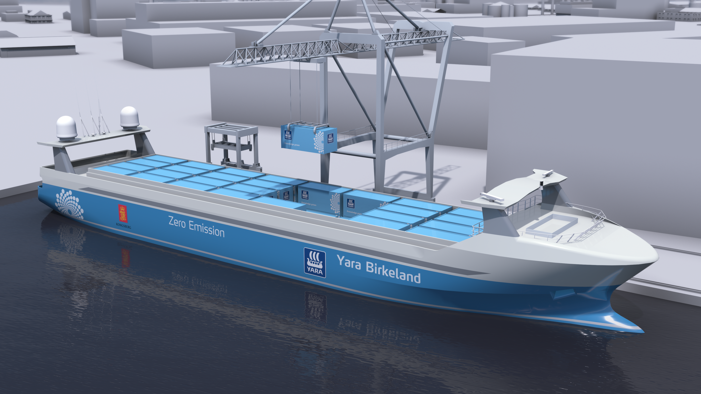
…
Notes:
Many projects are working on the realization of unmanned shipping. The first concepts were presented in the ’70s. But in 2013 there was a major project called MUNIN (Maritime Unmanned Navigation through Intelligence in Networks). They have worked on a vision for autonomous shipping, to determine which steps are necessary.
Follow-up projects work often in consortia or alliances. Rolls-Royce has been one of the major companies who has presented their vision early, and are involved in many of those projects.
The first picture is a render of a concept ship they have presented. The middle picture shows a ferry presented a few weeks ago. This ferry is designed with level 3 autonomy, where the crew can interfere from a remote location. The last picture shows the Yara Birkeland, this ship should operate autonomously in 2022 in a restricted area.
Each of these projects focusses on different challenges, with my research I focussed on the step after these projects.

Slide 5
Challenge of communication when and vessels meet
Manned
Unmanned
Necessity to communicate based on the manouvrability of vessels
Develop communication protocol
Notes:
Where ships are fully autonomous and people are taken out of the chain of command. For now, there will also be manned vessels around. To enable these ships to work together, communication is the most obvious solution.
I’ve have looked into the challenge of communication when manned and unmanned vessels meet.
This challenge can be solved by avoiding communication by making a decision well in advance, where I looked at the impact of manoeuvrability on the ability to avoid communication. The other option is to enable ships to communicate by developing a protocol. This have been the two subjects or my research

Slide 6
CONTENT
Decision-making process
Manouvrability characteristics
Closest point of approach
Critical evasive manoeuvre
Foundation
Design specification
Evaluation
Conclusion and recommendations
Notes:
I’ll start by introducing the research questions for each subject, followed by a more detailed explanation of these questions. Which I will eventually answer. I will do this for both solutions.
First I will discuss the impact of manoeuvring characteristics in the ability to avoid communication. To do this, I discuss the decision process, to show when a ship is in a critical situation. The manoeuvring characteristics during a critical evasive manoeuvre are determined for a specific use case.
The part on the development of a protocol first defines what should be considered, which results in design specifications. How the protocol is evaluated with seafarers is discussed last.
This is summarized at the end to draw conclusions and give recommendations for future steps.

Slide 7
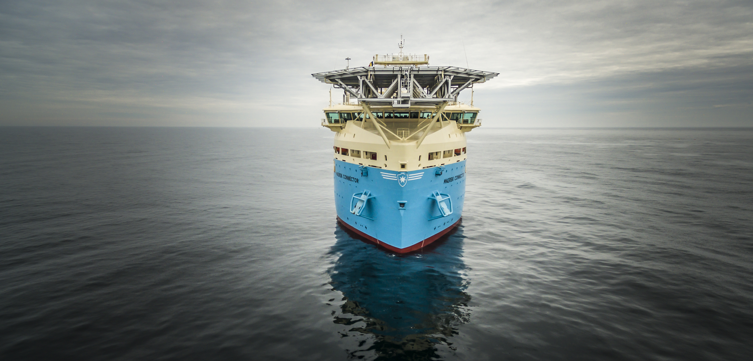
PART MT: IMPACT OF MANOEUVRABILITY ON THE NECESSITY TO COMMUNICATE
Notes:
This part is related to the research for my master degree in marine technology. Discussing the impact of manoeuvrability on the necessity to communicate.

Slide 8
How do ship manoeuvrability characteristics influence the domain for decision making, to ensure that the chosen strategy will result in a closest point of approach that does not require communication?
Notes:
The research question for this part is:
How do ship manoeuvrability characteristics influence the domain for decision making, to ensure that the chosen strategy will result in the closest point of approach that does not require communication?
First I will discuss some important terms in this research questions, followed by a use case to show how my method can be used to answer this question in general.

Slide 9
How do ship manoeuvrability characteristics influence the domain for decision making, to ensure that the chosen strategy will result in a closest point of approach that does not require communication?
Notes:
The first term I will discuss is the decision making. This process is analysed to determine what critical situations are and should be researched to give the answer.

Slide 10
DECISION-MAKING PROCESS
Mental model
Identify situation
Predict future states
Action
Strategy
Result
Notes:
The decision process has different phases. These phases are based on different models. The phases are the forming of a mental model based on acquired information, identification of the situation, predicting future states, deciding on the right strategy, resulting in actions and a new loop where results are evaluated.
The most relevant phases for this research are the identification of the situation, possible strategies and the results

Slide 11
DECISION-MAKING PROCESS
Mental model
Identify situation
Predict future states
Action
Strategy
Result
Passing
Crossing
Over-taking
Merging
Notes:
The situation can be identified with four keywords. Passing, crossing, over-taking and merging. This will be discussed later together with the use case.

Slide 12
DECISION-MAKING PROCESS
Mental model
Identify situation
Predict future states
Action
Strategy
Result
Follow planned path
Increase CPA by yourself
Cooperate with others
Emergency
Notes:
After predicting the future states is decided on the strategy, most favourable is to follow the planned path. The second option is to change course or speed without interacting with other vessels. The third option is to work together with others, this usually involves communication, if this is not successful, it becomes an emergency situation.

Slide 13
DECISION-MAKING PROCESS
Mental model
Identify situation
Predict future states
Action
Strategy
Result
CPA
Perceived risk
Safe situation
Notes:
These strategies are translated into actions. The new situation is then evaluated using different criteria. The closest point of approach is here one of the most critical. This can be used to determine the perceived risk, and finally, decide if it’s a safe situation.

Slide 14
How do ship manoeuvrability characteristics influence the domain for decision making, to ensure that the chosen strategy will result in a closest point of approach that does not require communication?
Notes:
The next keyword in the research question is the manoeuvrability

Slide 15
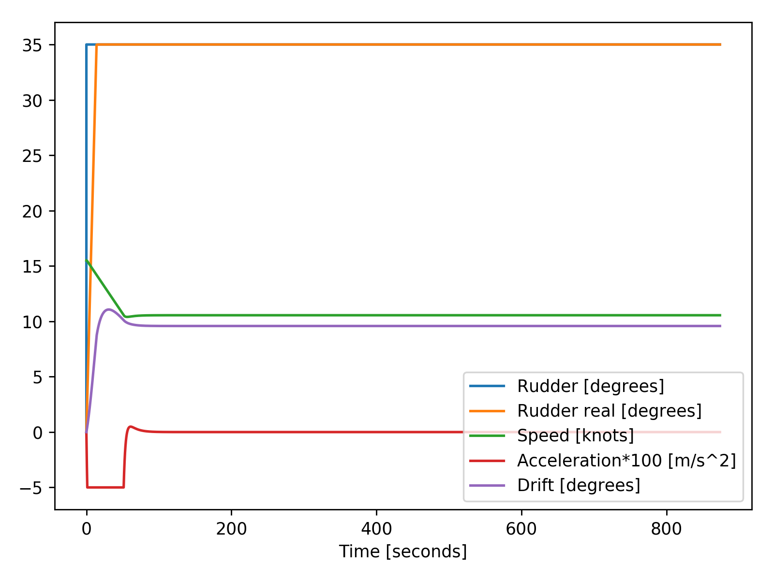
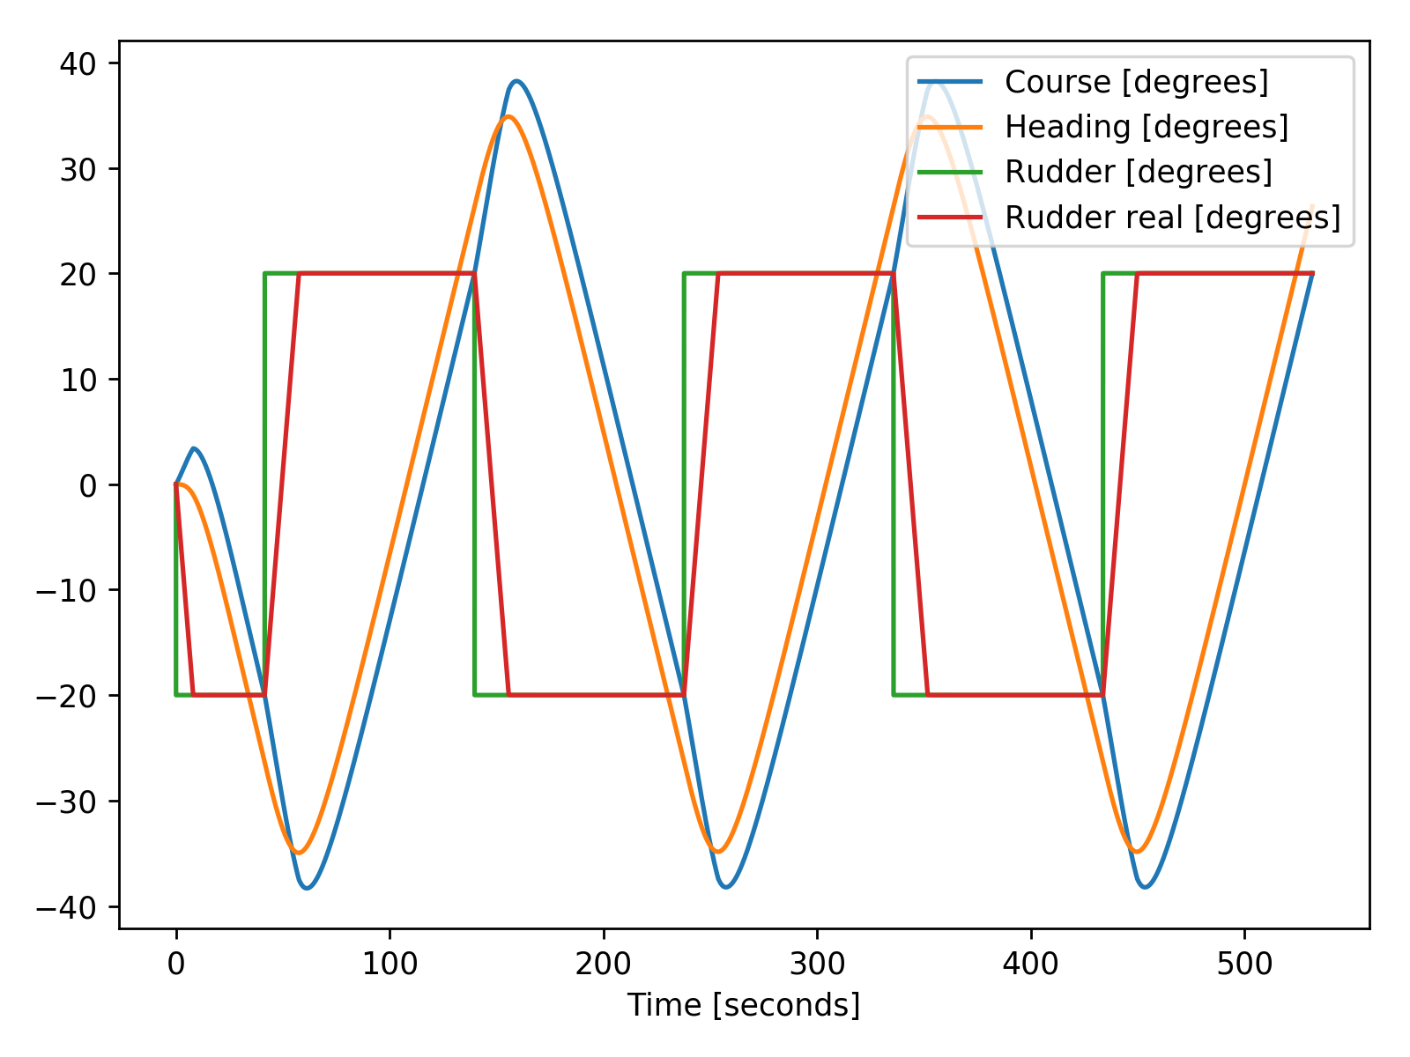
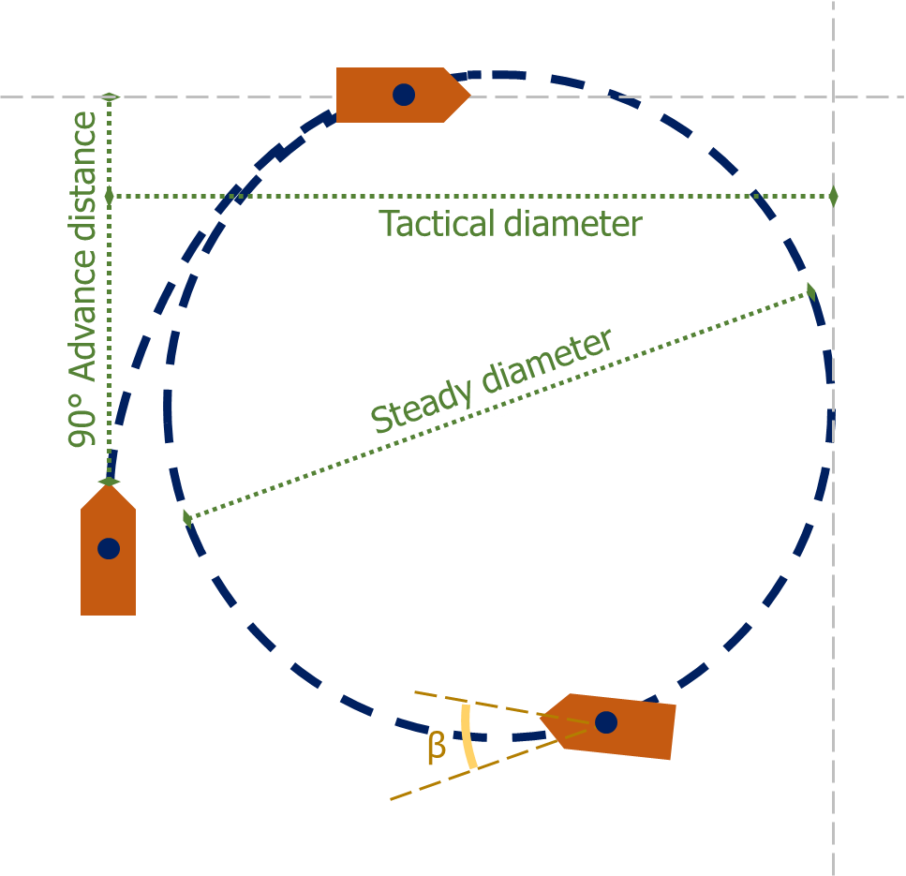
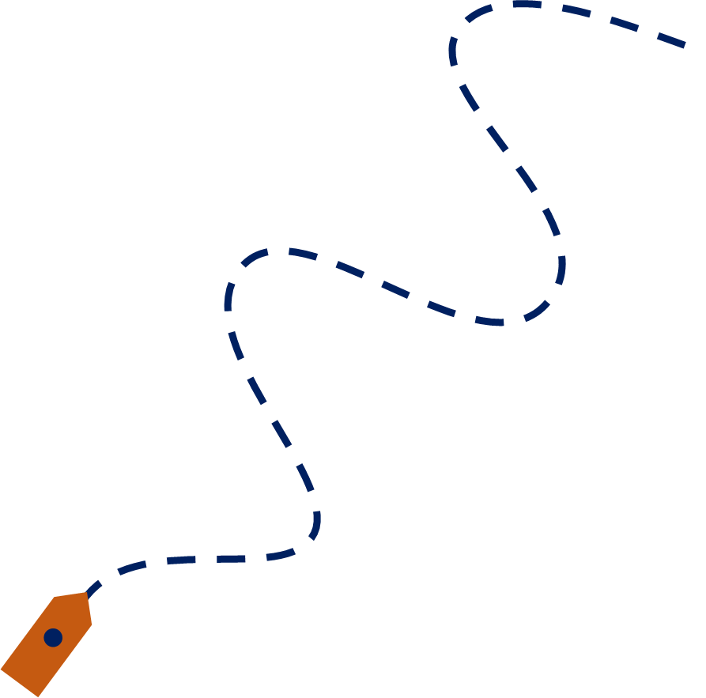
MANOEUVRABILITY CHARACTERISTICS
Advance distance
Tactical diameter
Steady diameter
Final speed
Overshoot
Notes:
When a ship is delivered the manoeuvrability characteristics are evaluated during the sea-trials. Two of the manoeuvres tested during the sea-trials are the turning circle test and the zig-zag test.
These tests are also used for the evaluation of the tool I used to simulate situations. I used here the tactical diameter, steady diameter, final speed and overshoot in the zig-zag test.
The advance distance is the manoeuvrability characteristic I finally used to answer the research question

Slide 16
How do ship manoeuvrability characteristics influence the domain for decision making, to ensure that the chosen strategy will result in a closest point of approach that does not require communication?
Notes:
The final keyword which is discussed before going to the use case is the closest point of approach

Slide 17
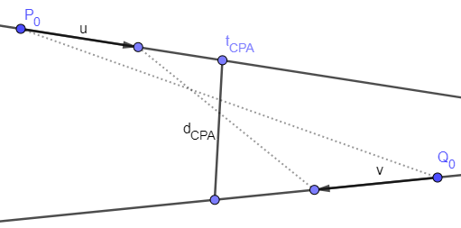
CLOSEST POINT OF APPROACH
d_{cpa}
Notes:
Today the closest point of approach is already calculated via different systems, such as ECDIS and radar. They used a linearized method. Where the distance is calculated between two moving points, using the speed vector and current location. Simple linear algebra is here sufficient.
However, ships do also change their course, certainly in critical situations. For these situations it is important to have a different manner of calculating the CPA. The algorithm I used predicts the paths of vessels and than calculates the distance between the location of each vessel at every timestep. The lowest distance is the closest point of approach.

Slide 18
How do ship manoeuvrability characteristics influence the domain for decision making, to ensure that the chosen strategy will result in a closest point of approach that does not require communication?
Notes:
Now we understand the research question, we can answer it with a use case

Slide 19
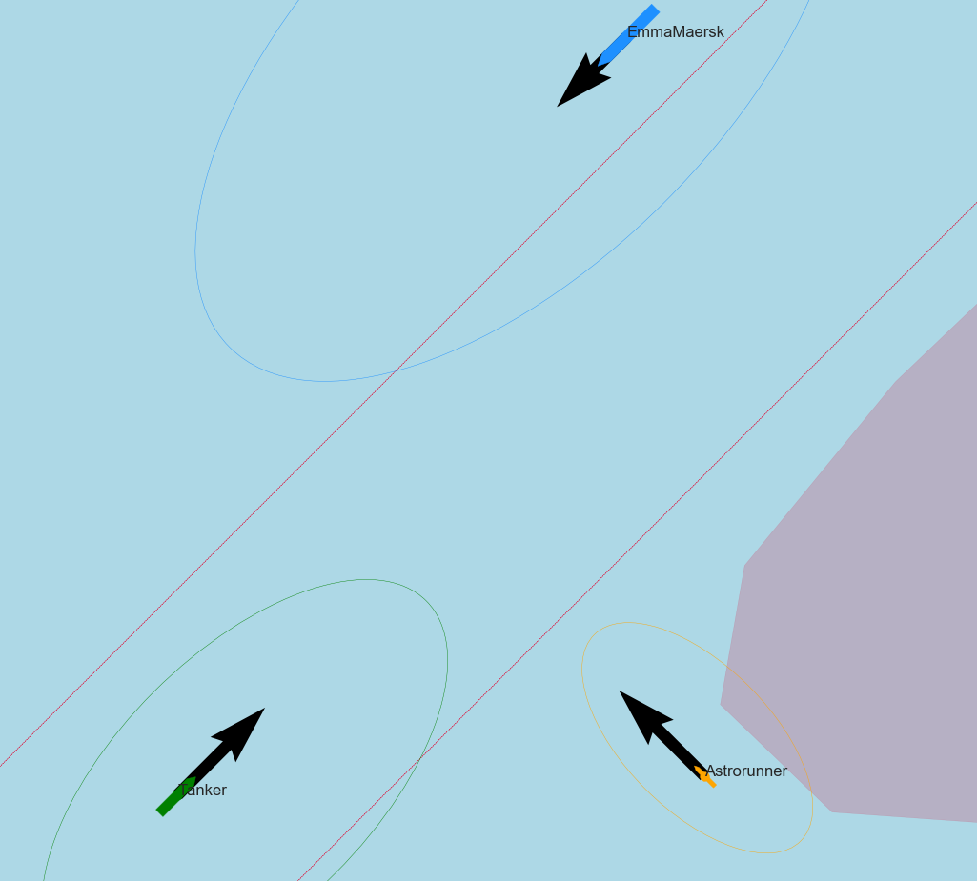
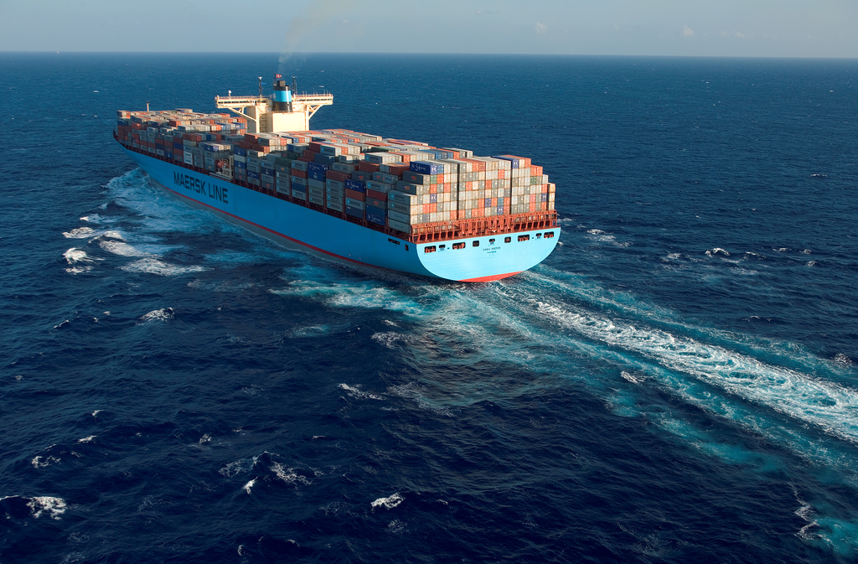
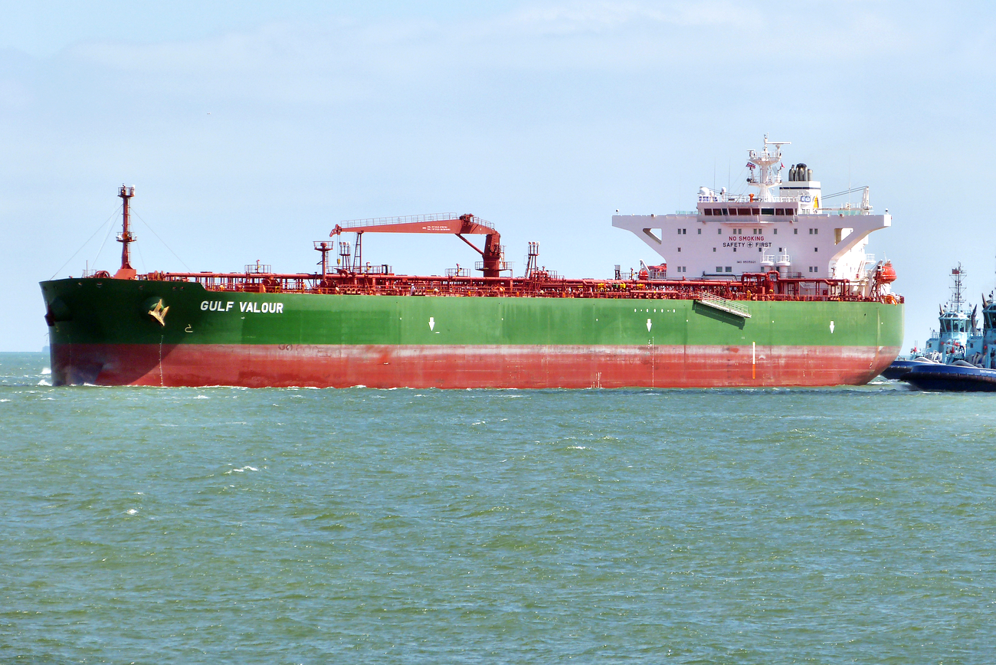
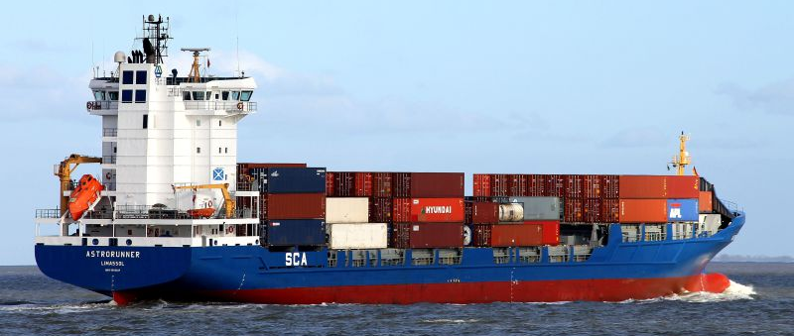
Length: 397m Deadweight: 156907 ton 12 knots
Length: 249m Deadweight: 114900 ton 15 knots
Length: 142m Deadweight: 9543 ton 15 knots
Notes:
Now we start to understand the research question, lets discuss the ships. The use case which is used, is a double crossing situation at the north sea. Three ships are involved. The small general cargo vessel Astrorunner. The Gulf Valour, a large oil tanker. I joined a pilot on this ship. The last vessel is the almost 400 meter, Emma Maersk, one of the largest container vessels in the world.

Slide 20
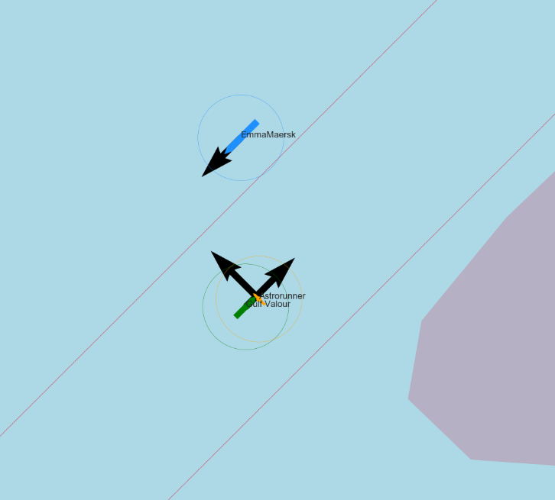
SITUATION
CPA: ~0 meter
Rule 15 from COLREGs
Keep course and speed
Notes:
When neither of the ships changes course or speed, will this result in a collision.
The COLREGs, which are the rules of the road for ships say that in this case the ship from starboard or right should keep course and speed, while the ship from port should give-way, thus manoeuvre in such a manner that a safe situation is acquired.
Thus the Gulf Valour has to change its course.
The Astrorunner becomes however the give-way vessel when crossing the Emma Maersk. Thus the Astrorunner has limited space to react.

Slide 21
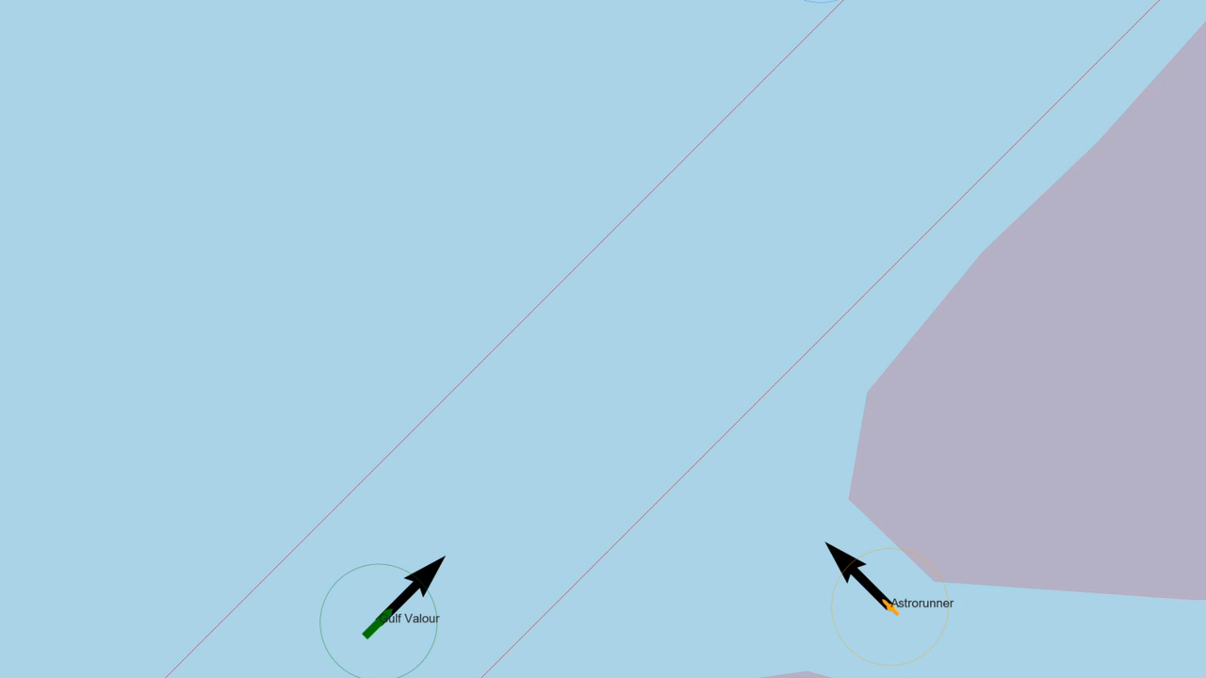
Notes:
The situation will look like this when played 10 times faster than real-time.
It can be seen that first the Gulf Valour gives way, when the Gulf Valour passes behind, the Astrorunner is allowed to change its course and speed. From that moment on it has to give-way to the Emma Maersk.

Slide 22
EVASIVE MANOEUVRE
Side distance (Y)
35 degrees rudder
No change in power
Reduction of speed due to manoeuvre
θ
Distance till initial CPA (X)
Notes:
During my research I’ve analysed the evasive manoeuvre which first the Gulf Valour used, and later the Astrorunner. Where the course is changed by giving maximum rudder. The speed reduces due to the drift angle, which is the difference between the course and heading. Resulting in a larger frontal area, more resistance, and the force from the screw is not in the direction of the movement, resulting in a lower efficiency.
The distance till initial CPA is here the distance till the collision. A combination of the distance travelled to the side, and reduction in speed will result in an increase of the closest point of approach.

Slide 23
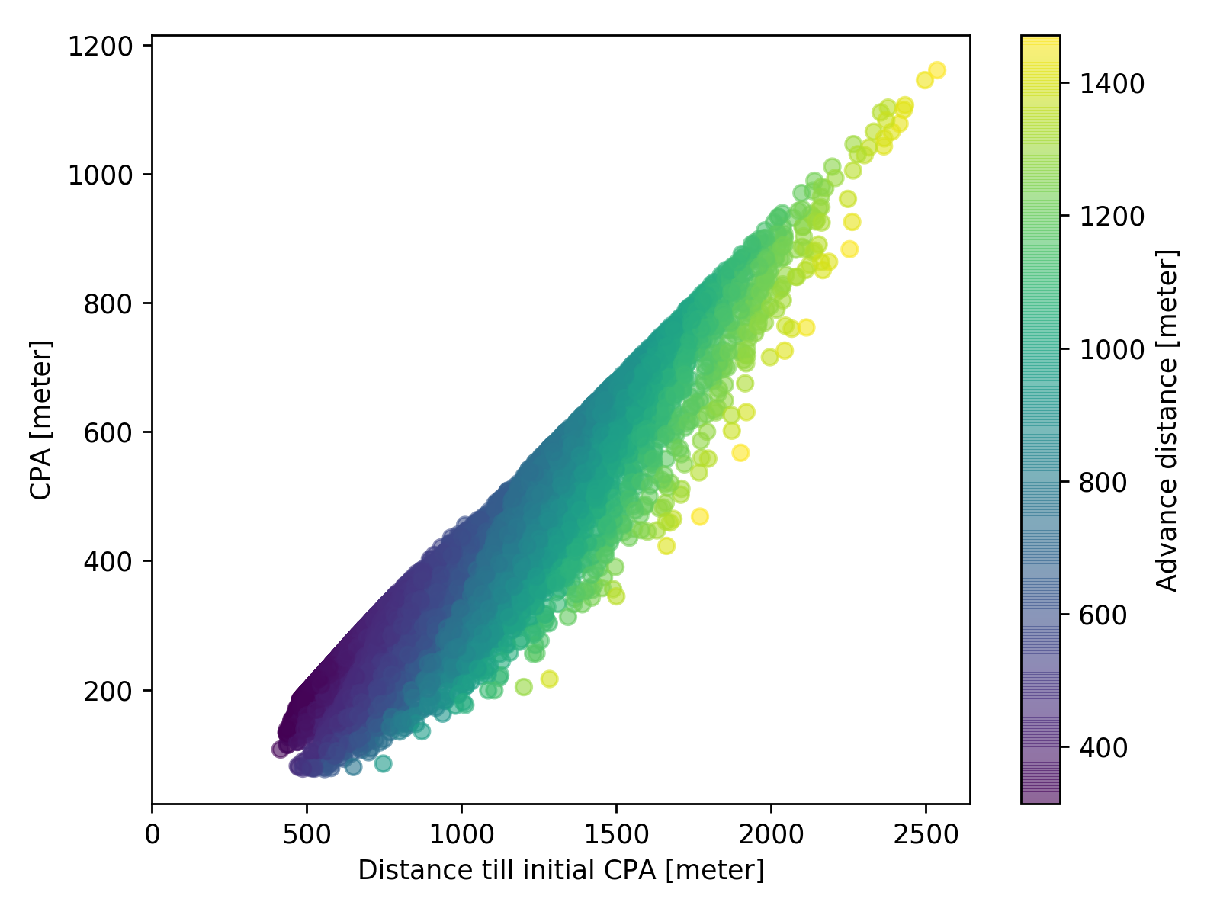
Relation between distance till initial CPA, resulting CPA and advance distance
Notes:
This manoeuvre have I simulated more than 9000 times. I’ve done this with the three different ships, thereby did I change its rudder configuration and start speed, resulting in different advance distances.
This helped me to find the relation between the distance till initial CPA, the CPA and advance distance in critical situations. Thus when there it is not sure if there is enough room for an evasive manoeuvre.
The maximum values at the top of this cloud of points show when the ship has turned 90 degrees. In this situation the two vessel become parallel, which means it is not a crossing situation anymore.
The relation have I used to evaluate the use case, and show how the advance distance influenced the decision making process.

Slide 24
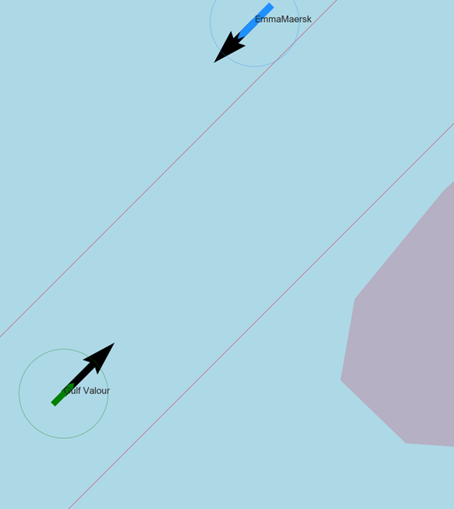
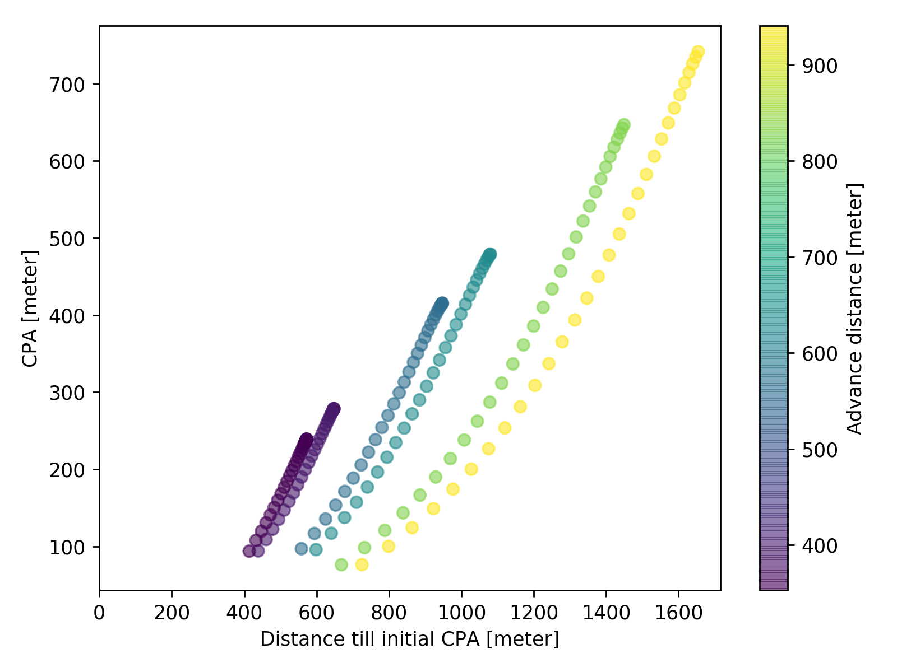
Emma Maersk
Gulf Valour
1060 meter
Astrorunner
Notes:
The red dotted line shows when a CPA of 370 meters is reached, which is acceptable according to various seafarers in busy areas. The green dotted line shows the distance the ship has left to manoeuvre in this specific situation. As is also shown in the figure on the right.
It can be seen that for the Astrorunner there is sufficient room to turn 90 degrees, which means that the situation is not critical for the Astrorunner.
When using the original advance distance for the Gulf Valour, can be seen that there is not sufficient distance left to turn 90 degrees, making this situation more critical. There is however sufficient room to increase the CPA more than 370 meter, thus the situation is accepted. When changing the rudder configuration by adding a rudder for example, the manoeuvrability improves sufficiently to enable the ship to turn 90 degrees within 1060 meter.
When the Emma Maersk is however placed at the location of the red ship. It can be seen that the Emma Maersk needs more than 1200 meters to do an evasive manoeuvre resulting in an CPA of 370 meter. Thus communication is necessary to avoid a collision, as action are needed from the other vessel.

Slide 25
GENERAL CONCLUSION
How do ship manoeuvrability characteristics influence the domain for decision making, to ensure that the chosen strategy will result in a closest point of approach that does not require communication?
Method works
Test more situations to find general manoeuvring requirements
Notes:
From my research including this use case can be concluded that the method works to determine if and why a situation is critical. By evaluating more situations can be determined what the minimal manoeuvrability characteristics are to ensure that the chosen strategy will resulting in a closest point of approach that does not require communication.

Slide 26
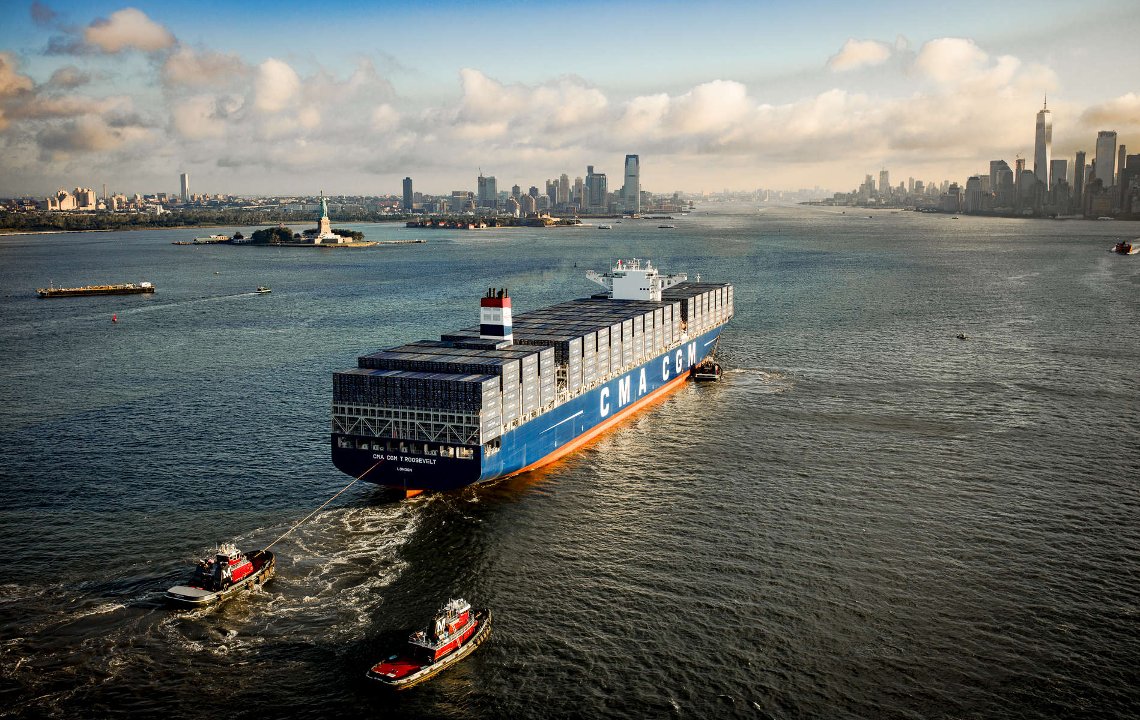
PART CS: PROTOCOL TO ENABLE COMMUNICATION BETWEEN MANNED AND UNMANND SHIPS
Notes:
Let us continue to the next part of this research, the development of a protocol to enable communication between manned and unmanned ships. In the previous part is already shown that there is a necessity for such a protocol. I will first introduce the research question. Next I will give a foundation on which the requirements will be based. I will present shortly the resulting design. Finally I will present the evaluation of the designed protocol.

Slide 27
Will a protocol based on existing maritime systems and communication protocols be sufficient to ensure safe navigation, while manned and unmanned vessels encounter each other?
Notes:
The research question for this part is: Will a protocol based on existing maritime systems and communication protocols be sufficient to ensure safe navigation, while manned and unmanned vessels encounter each other?
I will explain this research question by answering two sub-questions.

Slide 28
Will a protocol based on existing maritime systems and communication protocols be sufficient to ensure safe navigation, while manned and unmanned vessels encounter each other?
What is a protocol?
Notes:
What is a protocol?
A protocol defines the format and order of message exchange between two or more communicating entities, as well as the actions taken on the transmission or receipt of a message.

Slide 29
Will a protocol based on existing maritime systems and communication protocols be sufficient to ensure safe navigation, while manned and unmanned vessels encounter each other?
Why existing systems and protocols?
Notes:
Why existing systems and protocols?
The development of this protocol shouldn’t be the bottleneck for the development of unmanned vessels in general. Therefor it should be easy to implement, and quickly accepted by seafarers. Using existing systems and protocols will ensure this.

Slide 30
REQUIREMENTS FOR PROTOCOL
Easy to use
Easy to understand
Easy to implement
No negative effect on situational awareness
Notes:
The high-level requirements for the protocol are that it should be easy to use, easy to understand, easy to implement and may not have a negative effect on the situational awareness. User stories are used to define more detailed requirements.

Slide 31
TECHNOLOGIES
Radio communication
Conversational agent
Visible signals
Light signals
Mast head signals
Audible signals
Horn
Speakers
Flags
Heading, position and movements
Negotiating agent
SMCP with markerwords
Addressed AIS messages
Notes:
This has resulted in a design using the following technologies.
At the core of the protocol is communication via VHF radio. Where the agent on board of the unmanned vessel should be able to negotiate and communicate this to the manned vessel. By using standard maritime communication phrases is ensured that the communication is well understandable via radio. Thereby is SMCP becoming the standard, so no adaptions of seafarers are needed. An addition could be the usage of addressed AIS messages, as this is less complicated for computers to generate.
Thereby do seafarers like to know what kind of ship is close. Using different signals to show that the vessel is unmanned, will result in more trust from seafarers.
Within SMCP there are different speech acts. Each of these use marker words to show the purpose of the message. Advice, information, warning, intention, question, instruction and request.

Slide 32
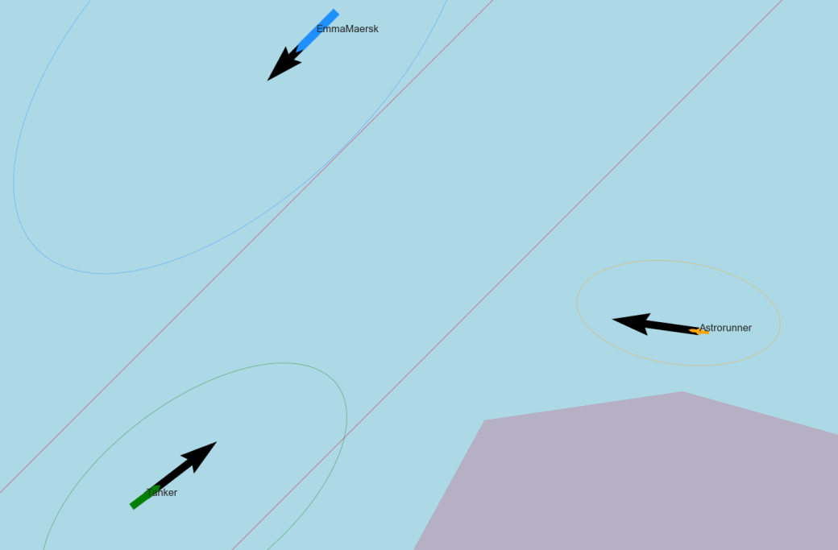
Length: 397m Deadweight: 156907 ton 12 knots
Length: 249m Deadweight: 114900 ton 15 knots
Length: 142m Deadweight: 9543 ton 15 knots
Notes:
For the situation which is also used as use case in the previous part will I show how the conversation will be between two vessels.

Slide 33
Use case example
Gulf Valour, Gulf Valour. This is Astrorunner. Over.
Astrorunner. This is Gulf Valour. Over.
Gulf Valour. This is Astrorunner. Question. Is your intention to alter course to starboard? Over.
Astrorunner. This is Gulf Valour. Question received. We will alter course to give way and pass one nautical mile astern. Over.
Gulf Valour. This is Astrorunner. Understood, you will pass astern. Have a good watch. Over.
Astrorunner. This is Gulf Valour. Over and out.
Notes:
Gulf Valour, Gulf Valour. This is Astrorunner. Over.
Astrorunner. This is Gulf Valour. Over.
Gulf Valour. This is Astrorunner. Question. Is your intention to alter course to starboard? Over.
Astrorunner. This is Gulf Valour. Question received. We will alter course to give way and pass one nautical mile astern. Over.
Gulf Valour. This is Astrorunner. Understood. Have a good watch. Over.
Astrorunner. This is Gulf Valour. Over and out.

Slide 34
EVALUATION QUESTIONS
Does the protocol influence the performance of seafarers?
Are seafarers confident that the protocol will act as expected?
Has the protocol a negative impact on the situational awareness?
Do seafarers like to use the designed protocol?
Notes:
This protocol is next evaluated. The questions asked during this evaluation are related to the dependent variables:
Does the protocol influence the performance of seafarers?
Are seafarers confident that the protocol will act as expected?
Has the protocol a negative impact on the situational awareness?
Do seafarers like to use the designed protocol?

Slide 35
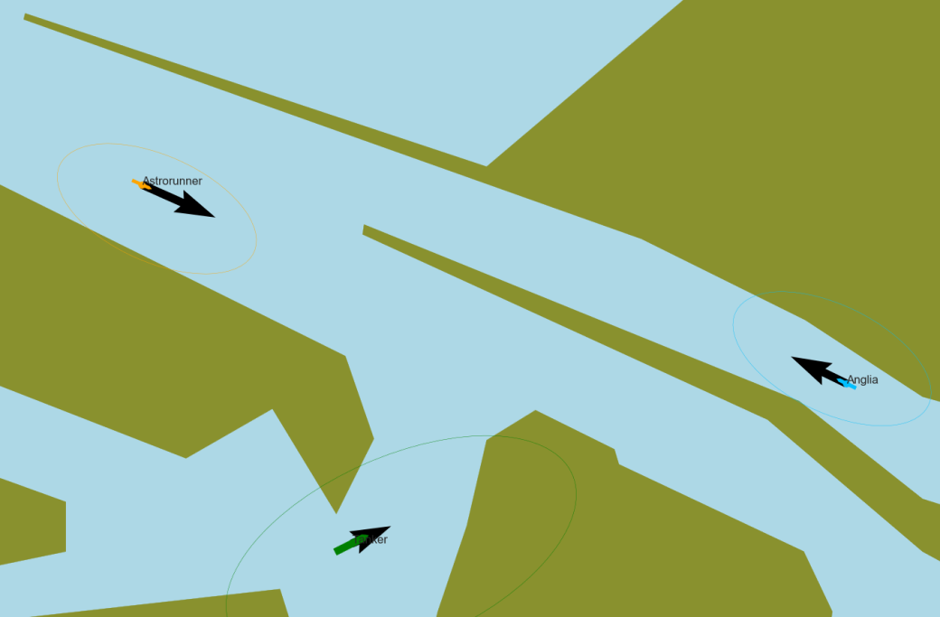
EVALUATION METHOD
Notes:
During the experiment the seafarers had to navigate in two situations. 16 seafarers did the experiment. I split the group in two, where the first group was only able to use the protocol in the first situation. Whereas the second group can use the protocol in the second situation.

Slide 36
DEPENDENT VARIABLES
Performance
Trust
Situational awareness
Satisfaction
Notes:
During the experiment four variables are evaluated, which answer the research question.
Performance, Trust, Situational awareness and Satisfaction.

Slide 37
DEPENDENT VARIABLES
Performance
Trust
Situational awareness
Satisfaction
Does the protocol influence the performance of seafarers?
Notes:
The performance is measured by checking if the participants followed the regulations and made the right decisions. The CPA was used as measure here. The usage of the protocol helped to make decisions early.

Slide 38
DEPENDENT VARIABLES
Performance
Trust
Situational awareness
Satisfaction
Are seafarers confident that the protocol will act as expected?
Notes:
The participants are confident that the protocol will work. As SMCP is an idiot proof system. They only worried about the voice recognition of non-western seafarers.

Slide 39
DEPENDENT VARIABLES
Performance
Trust
Situational awareness
Satisfaction
Has the protocol a negative impact on the situational awareness?
Notes:
The situational awareness had been checked by looking into the awareness to details. Such as the speed of other vessels, but also the color of the vessel. This showed the free cognitive capacity. There was no significant impact of the protocol, which means that it does not negatively affect the situational awareness

Slide 40
DEPENDENT VARIABLES
Performance
Trust
Situational awareness
Satisfaction
Do seafarers like to use the designed protocol?
Notes:
They really liked the usage of SMCP and VHF radio, as they can work in the same manner as they are currently doing.

Slide 41
LESSONS LEARNED FROM EXPERIMENT
Will the described protocol ensure safe navigation when manned and unmanned vessels meet?
Feasibility
More evaluations show impact
Notes:
From the experiment we have learned that it is feasible to develop a protocol based on existing systems and protocols. But to take the next step in developing the protocol, are more evaluations necessary, which show the impact of the protocol in more detail.

Slide 42
CONCLUSION
Will a protocol based on existing maritime systems and communication protocols be sufficient to ensure safe navigation, while manned and unmanned vessels encounter each other?
SMCP is a good foundation
Implement protoype
Notes:
From this research can be concluded that SMCP is a good foundation for developing the protocol. Thus the next step is to build a prototype which can be used for more detailed evaluations.

Slide 43
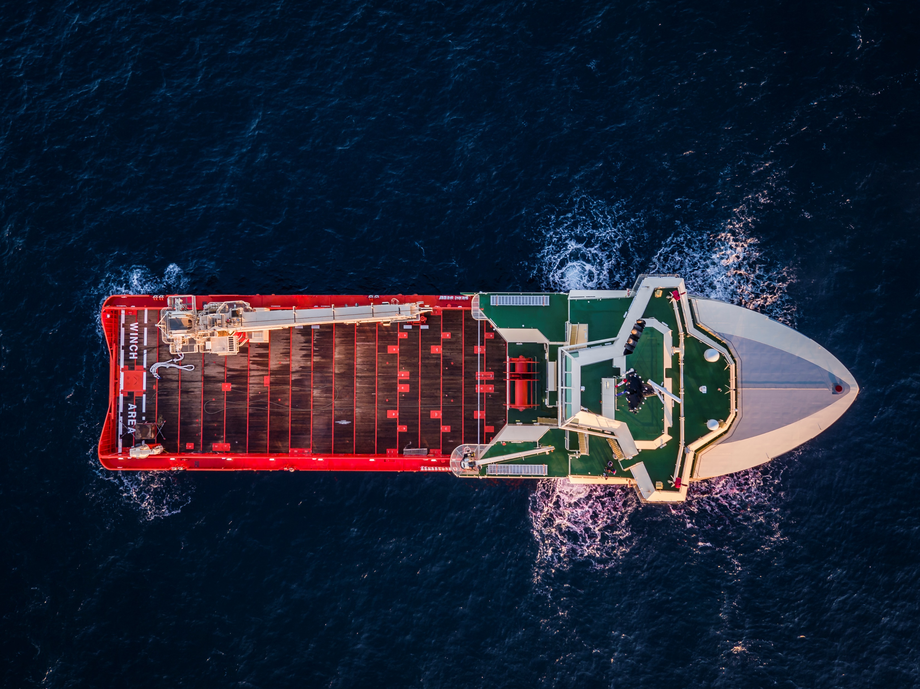
WRAP-UP: CONCLUSION AND RECOMMENDATIONS

Slide 44
Conclusion
Method
Relation
Communication
Standard Maritime Communication Phrases
Notes:
Method to evaluate situation works
Relation between manoeuvrability and decision domain is found for critical evasive manoeuvre
A communication protocol will be necessary
SMCP is a good foundation for protocol
First step

Slide 45
Recommendations
Hydrodynamic model
Other stakeholders
Uncommon situations
Notes:
Hydrodynamic model for more shiptypes
For protocol consider traffic controllers and surrounding vessels
Test redundancy in uncommon situations

Slide 46
QUESTIONS

Slide 48
PROTOCOL DEFINTION
Status of system
Listening, Waiting, Negotiating, Messaging, Updating, Unavailable
Types of message
Call, Acknowledge, Message, Response, Close
Speech acts
Advice, Information, Warning, Intention, Question, Instruction, Request
Notes:
Status of system
Listening, Waiting, Negotiating, Messaging, Updating, Unavailable
Types of message
Call, Acknowledge, Message, Response, Close
Speech acts
Advice, Information, Warning, Intention, Question, Instruction, Request

Slide 49
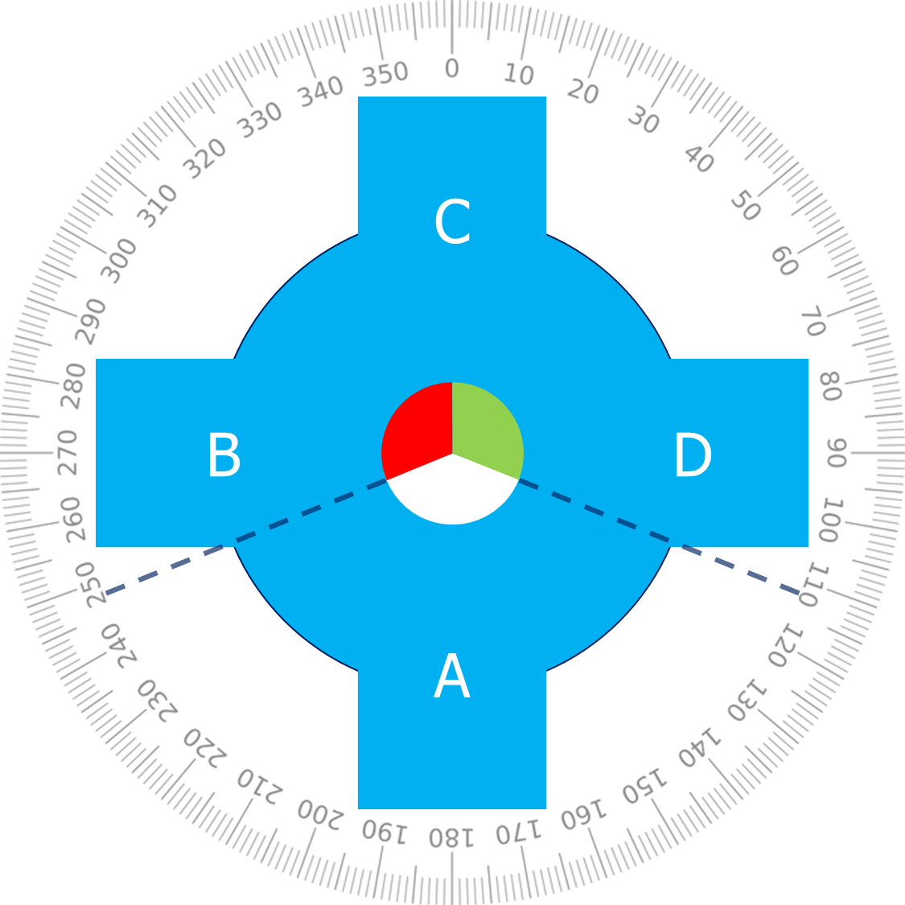
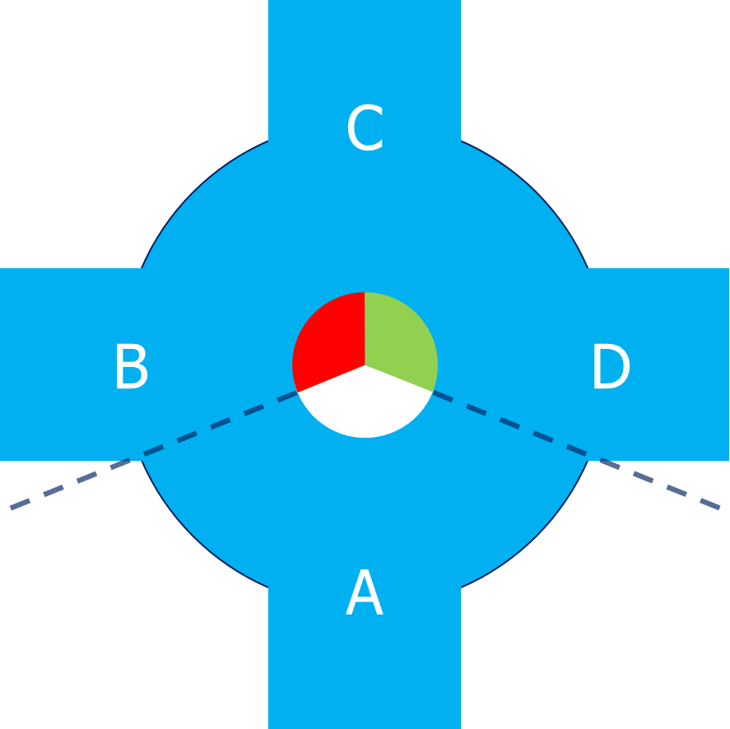
Identify situation
Passing
Crossing
Over-taking
Merge

Slide 50
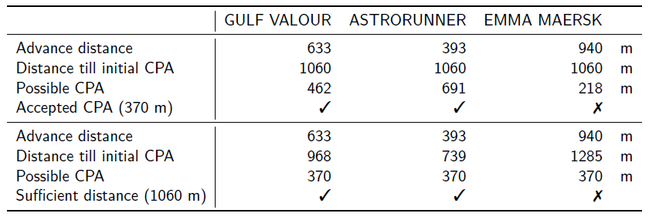
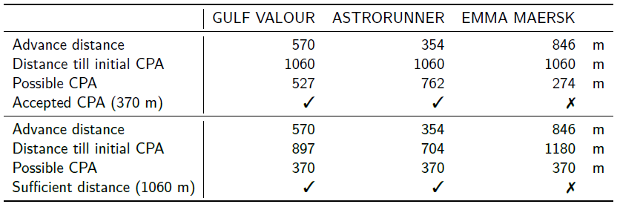
RESULT FROM USE CASE
Original advance distance
Improved advance distance

Slide 51
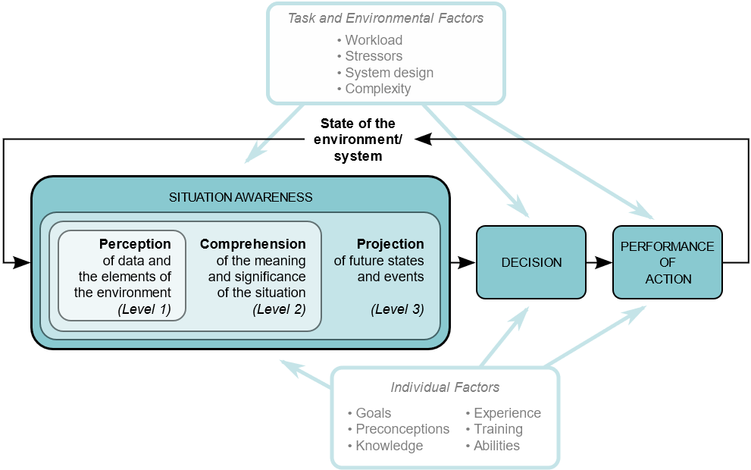
Situational awareness
Notes:
To answer this question we took the first step in developing a protocol. This protocol is developed using the situated cognitive engineering method. This method considers the role of the human. Answering the following two questions gives more insight in this role.
What is required for human computer teamwork?
Both should be able to anticipate on the teammates needs, this is only possible when the behaviour of others is understood. Situational awareness is key here.
What is situation awareness and how is it acquired?
To acquire situational awareness there are different phases as shown in the Endsley model, comparable to the decision process as presented in the previous part.
Perceive the situation around you, thus collect information. The next step is comprehension, understand what this information means to you. The third step is predicting what this means for future states. Based on this is decided what to do, and an action is undertaken.

